Slide 1
Fake News Detection

Slide 2
Executive Summary
We have witnessed a dramatic change in our society as a result of the emergence and use of digital platforms for the production, dissemination, and consumption of news. The challenge for digital platforms in the age of disinformation today is the fact that they have become a forum for campaigns of misinformation that have direct and indirect effects on the credibility of all of the news ecosystems. The emergence of fake news has fast become an increasingly troubling worldwide phenomenon, particularly in the absence of scalable platforms for fact-checking that are affordable and scalable.
The use of automatic solutions for detecting fake news can thus be used as a supplementary tool to determine which article is likely to be fake, or which article merits further investigation by fact-checkers. There are many fake news articles written on purpose in an attempt to fool the public into believing the propaganda, making it difficult to detect since it is written with the intent of mislead the public (Mahir et al., 2019).

Slide 3
Executive Summary
There's no denying that fake news has been detrimental to the general public's mindset. In the modern age of fake news in the media it is important to check whether the information is authentic, due to the widespread spread of fake news on the internet.
To tackle this problem, we propose a method that uses machine learning to detect fake news. The purpose of this project is to explore practical approaches for discovering fake news in the context of the digital platform context, by investigating how these can be automated and detected.
The first step in our research is to make a survey of a large number of articles on fake news that have recently been published as an attempt to implement all possible detection mechanisms. The purpose of our study is to analyse labelled datasets and propose two novel features that are useful in assessing prediction performance in supervised machine learning approaches.

Slide 4

Project Motivation/Background
In this digital age, more than one-third of the global population uses digital platforms, such as social media networks and messaging programs to stay connected (Gallagher, 2017).
These platforms have drastically changed the way in which users interact with each other and communicate over the Internet, providing the opportunity to create entirely new types of applications, as well as modifying the existing information eco system.
A particularly important change in how news is produced, distributed, and consumed has been the growth of digital platforms, which offers many opportunities, but also introduces many challenges as well.

Slide 5
Project Motivation/Background
As a consequence of the characteristics of these digital platforms, this change has been spurred by a number of factors: (i) The cost and time constraints for producing and consuming news on these platforms are often less and faster than those for traditional news sources, as they are for newspapers and telecommunications; (ii) additionally, viewers are able to share news, comment on it, and participate in discussions on digital platforms, which allows them to interact and communicate with their friends and fellow readers through the use of social media (Shu et al., 2017).
Hence, we can say that digital platforms are creating a paradigm shift in how information is consumed by people. About 62% of the American population and 66% of the Brazilian population nowadays receive their news through digital channels (Mitchell, 2016).

Slide 6
Project Motivation/Background
There is no denying that the flood of fake news, which is being spread on digital platforms, has severely harmed the health of the world. An example is that an online advertisement for an experimental cancer treatment was interpreted as medically valid information by a cancer patient, and ultimately the cancer patient died (Dai et al., 2020). As a result of the COVID-19 pandemic, we have seen an increase in the occurrence of rumours and conspiracy theories spreading across the internet.
In the context of digital news platforms, one of the things that further contributes to the emergence of fake news is that almost anyone can set up/appoint themselves as a news publisher free of cost (for example, an individual who believes they are a news media organization or newspaper can create a Facebook page to spread news, or they can start a WhatsApp group for spreading fake news).

Slide 7
Project Motivation/Background
Because of this, it is not only traditional news organisations that are increasingly moving towards digital platforms, but many other news outlets are also establishing themselves on these platforms in the process. It should be noted, for instance, that previous studies have found that during the course of 2018, Facebook in the United States had grown to more than 20,000 pages that publish and share news stories (Ribeiro et al., 2018), a figure which continues to rise steadily.
A surprising number of findings were revealed in the survey, where it was shown that over 98% of interviewees had been exposed to at least one fake news account, and over 90% of the respondents believed that the news stories were true.

Slide 8
Project Motivation/Background
The consequence of these factors is that both the results of the 2018 elections in Brazil and the democratic process in Brazil suffered as a result. The number of false allegations, deceptions, spins, and lies has existed for a very long time, but with the emergence of digital platforms, misinformation has become more and more widespread, causing the issue of fake news to become a concern that affects the whole world, especially when a lack of research-based fact-checking strategies is a cause for concern.
Thus, in the scenario presented here, we hypothesize that by detecting fake news automatically, we can be able to use a useful level of discrimination in the process of identifying what is more likely to be fake content, thereby supporting the process of fact-checking while also minimizing the unintended consequences of fake information widely distributed through digital channels.

Slide 9
Project Motivation/Background
The most important piece of information to understand when working on fake news detection is the concept of what fake news is and how it can be distinguished from real news. It is important to be able to differentiate the two in one of two ways: either characterization or detection. To create a detection model, characterization is critically important. In other words, in order to detect fake news, one must first be able to identify what is fake news, before trying to build a detection model.

Slide 10
Project Motivation/Background
The definition of fake news is based on two components: the legitimacy of the news and the intention behind it. By authenticity, we mean that fake news contains false information which can be verified to be false, so this implies that conspiracy theories are not part of fake news since in most cases it is difficult to prove whether an assertion is true or false. As for the second part, intent, assumes that the false information is written with the intent of mislead the reader.

Slide 11
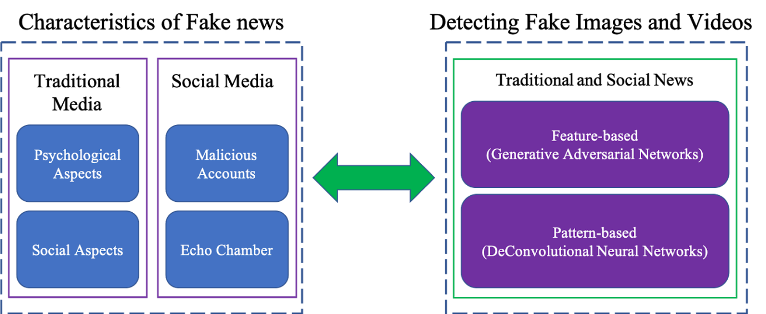

Slide 12
Importance
We are living in a social era where understanding the difference between right and wrong, When, what, and why of any news is important to understand. Awareness of fake news detection and classification is slowly becoming a fundamental necessity for society in order to avoid the phenomenon of reality vertigo, as well as to protect less educated members of society. There have been numerous approaches proposed to address the issue of machine learning.
Our socio-economic life is affected by fake news in a significant way, especially our political environment. The detection of fake news is an emerging area of research, and it has gained considerable interest, but it has also been hampered by a limited amount of available resources (for example, datasets and published literature).

Slide 13
Problem Statement
There has long been a problem of fake news in the news industry - the production of misinformation and propaganda as well as hoaxes and satire have always been a concern. There are no boundaries anymore when it comes to what can be published on the Internet. This includes anything credible or not credible. Therefore, this exposes people to the possibility of being deceived intentionally or unintentionally, and they are more likely to share such types of news without reason to the ends of the earth. With machine learning and artificial intelligence, we may be able to overcome the counterfeiting of news problem or at least make it less common. It has been concluded that the detection of fake news is usually considered a challenging task (Manzoor et al., 2019), requiring the application of a multidisciplinary approach. For deception detection, there exists a large body of research (Khanam et al., 2021) done where machine learning methods are applied.

Slide 14
Problem Statement
Although the classification of fake news is not sufficient to detect them as it overlooks the important context of information in the news, a thorough examination of the content may be useful to detect false news. With the combination of the context-free grammar software (CFG) and the N-gram program, context-free grammar produced good predictions for deception classification. On the basis of a classification algorithm, 85%-91% accuracy was achieved when applied to news article datasets (Sharma et al., 2019).
Taking the subject of classification in this context, it is our hypothesis that simple classification alone will not be sufficient to solve the problem; we need to employ machine learning techniques together. This hypothesis will be proven by developing a model on publicly available datasets, after several experiments, based on the hypothesis.

Slide 15
Data Statistics
The dataset we are using is downloaded from Kaggle(Fake and Real News Dataset | Kaggle, n.d.)
We have a data set which contains all of the news stories around Real or Fake News or Text Datasets.
There are only four columns in this data set.
title
text
subject
date
there are two csv files in the dataset.
True.csv
Fake.csv

Slide 16
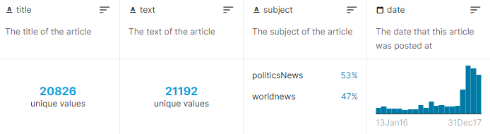
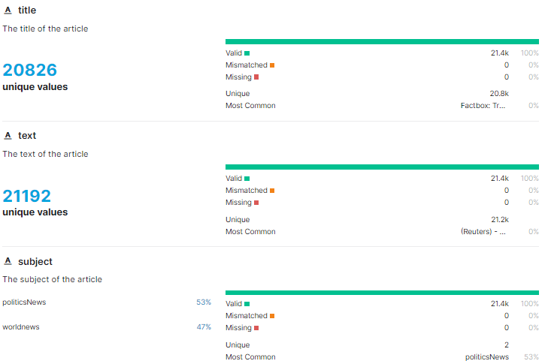
True.csv file

Slide 17
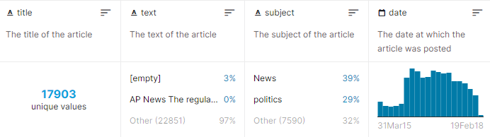
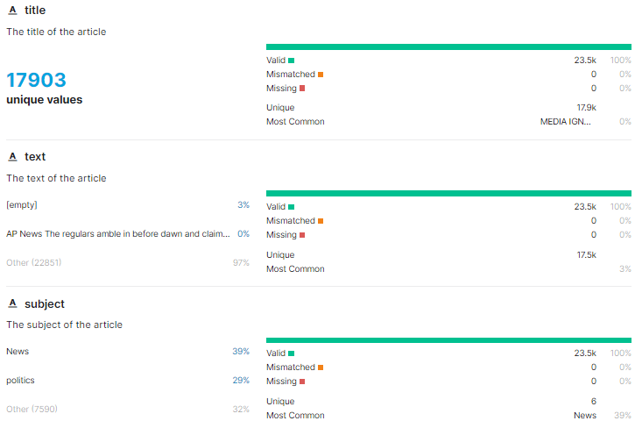
Fake.csv file

Slide 18
Data preparation activities
The machine learning algorithm can only process numerical features so the text data must be transformed into numerical columns so that the algorithm will work. The text must be pre-processed in order to make sense of it, and this process is known as Natural Language Processing.
As part of text pre-processing, we will clean our text using steaming, lemmatization, removing stop words, removing special symbols and numbers from the text, etc. The data has to be cleaned first and then we have to feed these text data into a vector evaluator that will turn it into a numerical feature.
The datasets are downloaded from Kaggle and then we analyse them. One dataset deal with fake news, while the other will deal with true news. there are 21417 news articles in true news, and there are 23481 in fake news. In both datasets, there is a label column with 0 representing true news and 1 representing fake news. These two datasets are then combined using a pandas built-in library of python.

Slide 19
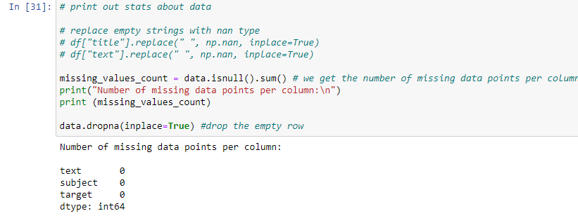
Exploring missing values in dataset
We explored if there are any missing values in the dataset.
From output, it can be seen that there are no missing values.

Slide 20
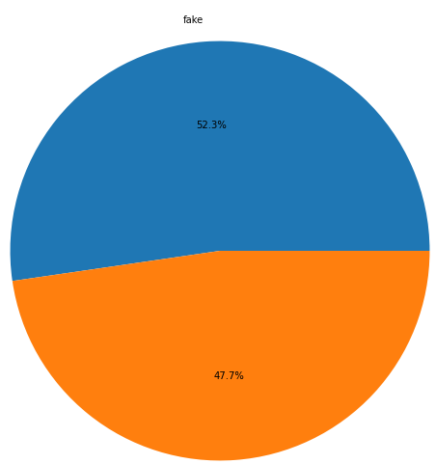
Visualizing dataset for distribution of class labels
Based on the chart above, we see that the data is fairly evenly distributed amongst the two classes.

Slide 21
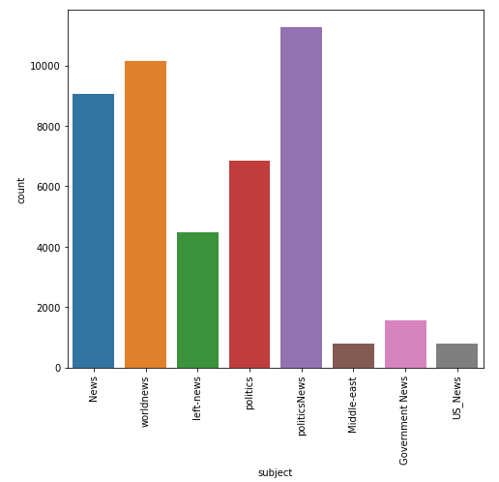
Plotting a count of all subjects in the true news

Slide 22
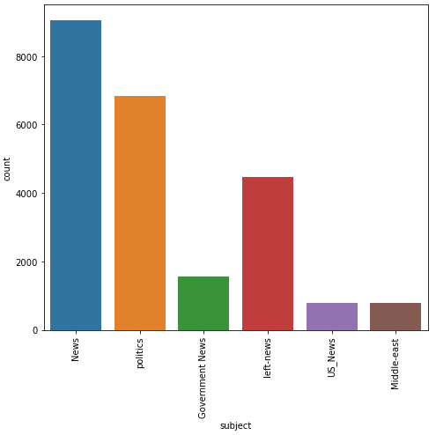
Plotting a count of all subjects in the fake news

Slide 23
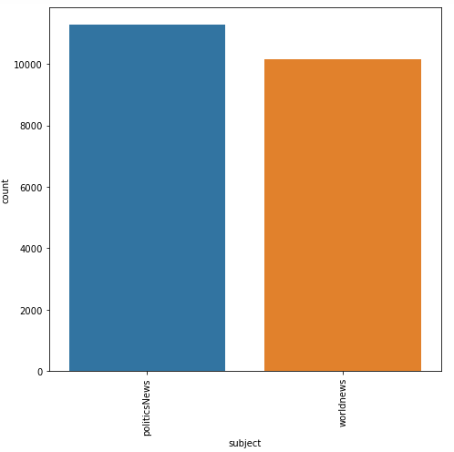
Visualizing the news coverage of each topic

Slide 24
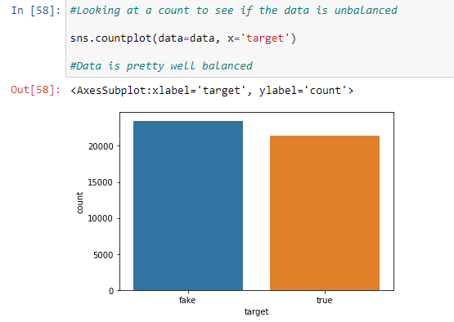
Exploring for imbalanced data
It can be seen from graph that data is well balanced.

Slide 25
Data Pre-Processing
When it comes to data processing, we are mostly going to concentrate on the text column on this data, which is actually what holds the news.
In the future, we are going to change this text column in order to extract more information and make the model more accurate.
This whole procedure will be carried out with the help of a tool called nltk, a library that enables us to extract information from the text in a column.
Using the nltk library in this case, we will use the functions related to removing stopwords, tokenizing, and lemmatizing.

Slide 26
Data Cleaning Steps
First step is to perform data cleaning which involves following steps;
Converting Upper case to Lower case
This step involves converting the upper case to lower case so that each sentence follows same pattern and does not affect the accuracy.
Removal of punctuations
This step involves removing all special symbols so that they do not affect accuracy.

Slide 27
Data Cleaning Steps
Removal of stop words
In almost any language, there are words, pronouncements, and phrases that are used to make connections between words and to indicate the tense of sentences. The consequence for us as users of these words is that when we use them in sentences they don't really add anything to the meaning of the sentences, which means that even when we remove the stop words, we can still understand what is being said.
Tokenization
By tokenization we mean breaking a text into smaller pieces which are referred to as Tokens. A token in Natural Language Processing may be a word, a special character, or a number found within a sentence.

Slide 28
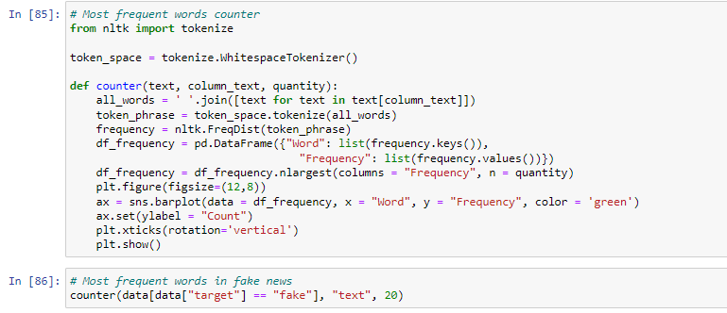
Data Cleaning Steps
After performing data cleaning steps, we performed tokenization as follows and outputs are shown ahead:

Slide 29
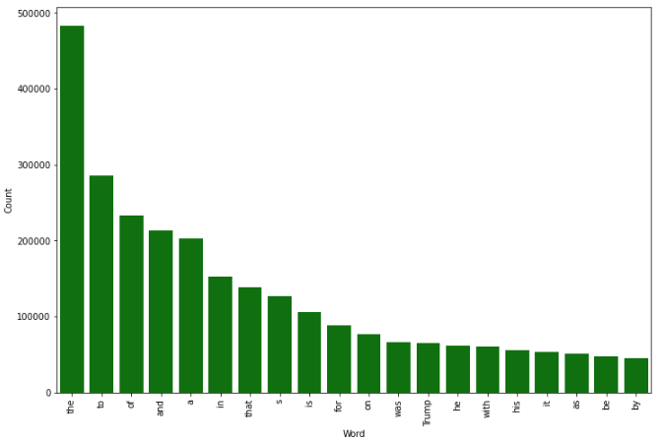
Fake news after tokenization

Slide 30
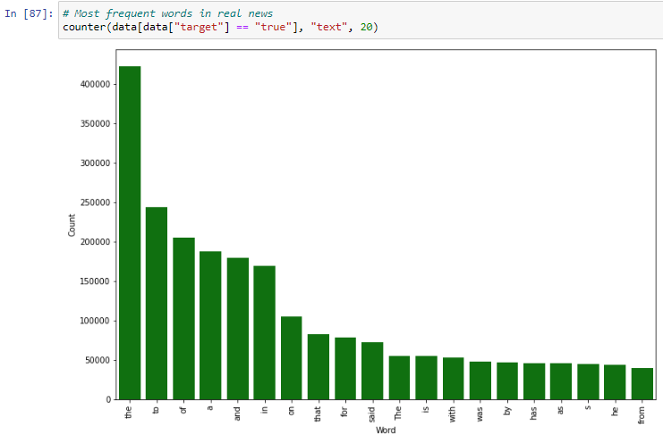
Real news after tokenization

Slide 31
Data Analytics
In our proposed framework, we intend to consolidate on the current literature by combining ensemble techniques with a variety of linguistic features sets in order to classify news articles from multiple domains as true or false.
An innovative approach that makes use of the ensemble techniques is the one we have suggested in this research. An ensemble method is a technique that creates multiple models and then combines them in a way that produces improved results at the end. These methods are generally more accurate than trying to solve the problem with a single model.

Slide 32
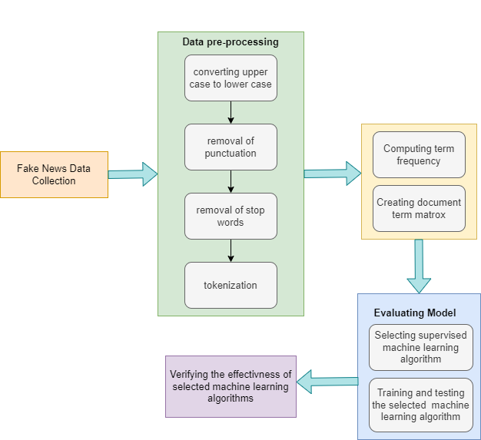
Flow diagram of proposed method

Slide 33
Visualization Technique
Businesses often discover that visualizing data (like graphs, charts, infographics, and so on) is a valuable alternative to presenting important information at a glance.
A word cloud can convey crucial information in a visually stunning way and make dull textual data seem more interesting, highlighting important textual data points in a captivating manner.
Essentially, word clouds (also referred to as tag clouds or weighted lists) are visual representations of text data. Each of the words that are displayed is normally a single word, and the size and colour of the font indicate their significance. There is a Python library which permits us to create these word clouds.

Slide 34
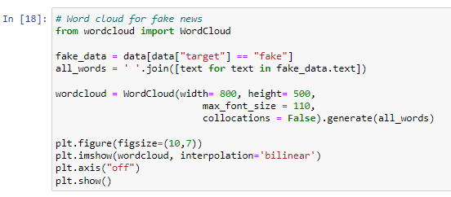
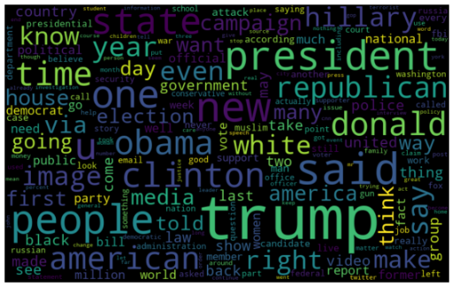
Word cloud for fake news

Slide 35
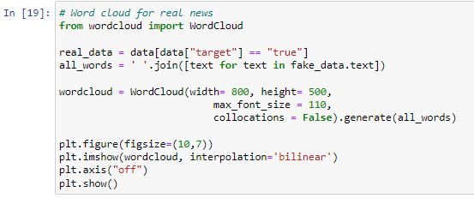
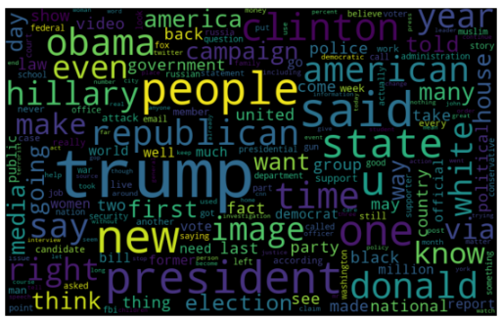
Word cloud for real news

Slide 36

Algorithms Used
Naïve Bayes
The Naive Bayes algorithm works according to the Bayes' Theorem, which is based on the conditional probability.
A classifier can be defined by calculating the maximal posterior, which is calculated by taking the maximum P (Ci, X) generated by the Bayesian search with the assumption that it is applied to Bayesian framework. With this assumption, the cost of computation is greatly reduced by counting only the distribution of classes.

Slide 37
Algorithms Used
2. Logistic Regression
In supervised learning, a logistic regression algorithm predicts the probability of a target variable by using a classification algorithm. It would only be possible to have two classes for a target or dependent variable if it is dichotomous.
To put it simply, the dependent variable is a binary variable, containing data that is coded either as 1 (represents success/yes) or 0 (represents failure/no).

Slide 38
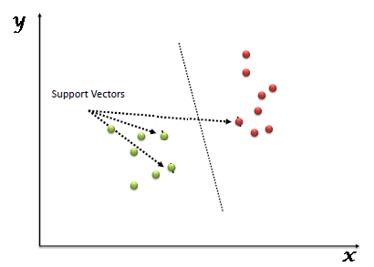
Algorithms Used
3. Support Vector Machine
As part of the SVM algorithm, we are plotting each item of data as a point in a n-dimensional space. (N is the number of features you have) Where the value of each feature corresponds to the coordinates of the item of data. Then, we conduct classification based on finding the hyperplane that best distinguishes between two classes as follows.

Slide 39
Algorithms Used
4. Decision Tree
The Decision Tree algorithm is a supervised learning algorithm. An effective way to make use of Decision Trees is to create a training model which can then be used with a variety of learning algorithms to predict the target variable by detecting simple decision rules based on prior information (training data).
The decision tree method involves starting from the root of the tree to determine the class label for a record. The root attribute values of the record are compared with the values of the root attribute. Then we compare the two values and follow the branch that corresponds to this value and go to the next node in the tree.

Slide 40
Algorithms Used
5. Random Forest
The Random Forest algorithm is one of the most important features of the theory that it can perform a classification and regression analysis with data sets consisting of continuous variables in the case of regression and categorical data in the case of classification. The Random Forest algorithm has a better performance when classifying data. This is an ensemble machine learning method called Bagging or Bootstrap Aggregation.
The ensemble technique of random forests is called bagging. This technique randomly samples data. As a result, each model is generated from them (Bootstrap Samples). Each model is then trained independently, generating results. Based on combining all results, the final result is a majority vote. In an aggregation process, all votes are combined and the result is based on a majority of votes.

Slide 41
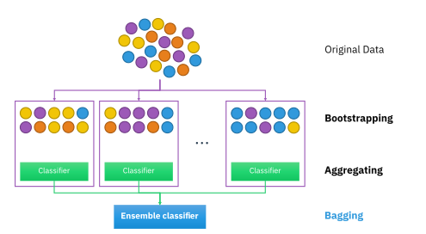
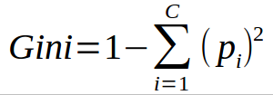
It is an important fact to note that for the classification problem, a cost function called Gini Index was applied in our model to estimate what amount a dataset will split into.
A Gini Index is calculated by squaring the probabilities of each class and then subtracting that sum from one.

Slide 42
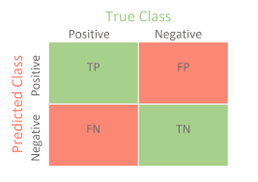
Performance Metrics
Confusion Matrix
The confusion matrix has been used as a tool to evaluate the performance of the algorithms. Confusion matrix is a table that represents the performance of a classification model with respect to a given dataset, which is divided into four categories: true positives, false positives, true negatives, and false negatives.
Confusion Matrix

Slide 43
True Positives (TP)
These are the values that are a correct prediction of positive results. The predicted value must also be true if the actual value of the class is true.
True Negatives (TN)
These are the values which indicate that a prediction was correct, meaning that both the actual and predicted classes are negative.
False Positives (FP)
This refers to situations where a class is accurate, but an incorrect prediction for the same class is produced.
False Negatives (FN)
In this case, the actual class is “yes”, but the predicted class is “no”.

Slide 44
Analysis of Results
Data retrieval is the first step of the process in which data is retrieved.
This particular data was downloaded from Kaggle.
After this, we split up the data samples into training and testing groups. In our approach we divide data using 80.20 rule.
Which means 80 % data is for training and 20% of data is for testing purpose.
Then the selected machine learning algorithms are trained on the dataset.
In the last step, we evaluate the performance of each algorithm through confusion matrix.

Slide 45
Analysis of Results
Algorithms | Accuracy
Decision Tree | 99.61%
Support Vector Machine (SVM) | 99.45%
Logistic Regression | 98.79%
Random Forest | 98.69%
Naïve Bayes | 93.94%

Slide 46
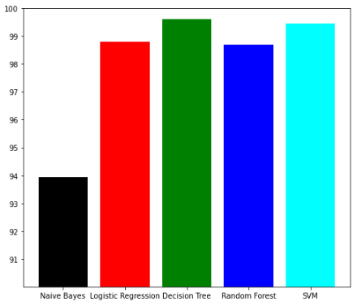
Findings
In this section, we will analyze the results after performing machine learning algorithms on the dataset and will present findings at end of section.
Comparison of classifiers’ accuracy in python

Slide 47
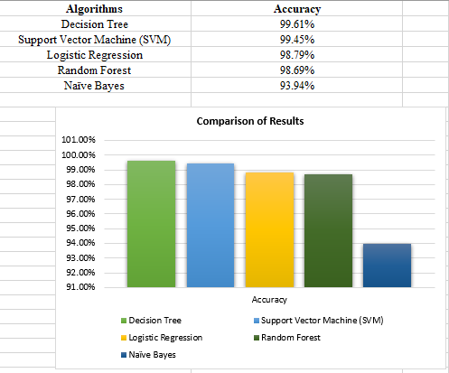
Findings
Comparison of classifiers’ accuracy in graph

Slide 48
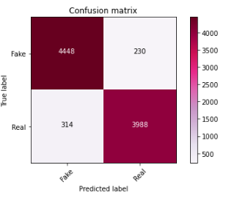
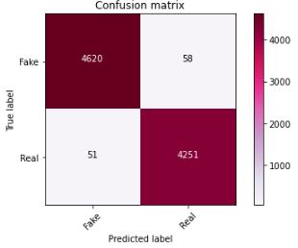
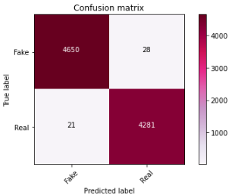
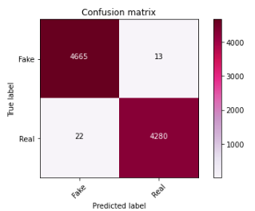
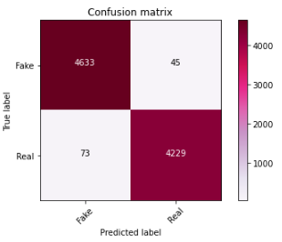
Findings
Naïve Bayes
Logistic Regression
SVM
Confusion Matrix Results Comparison
Random Forest
Decision Tree

Slide 49
Findings
A summary of the accuracy assessed by each algorithm on the final dataset can be seen in the above graph. On the other hand, we can conclude that the Decision Tree has achieved the highest accuracy on a scale of 99.61%.
On the other hand, Support Vector Machines (SVM) achieve some of the highest accuracy which is 99.45%. However, Random Forest achieves a 99.69% accuracy which is the next highest accuracy.
On the contrary, the level of accuracy of Logistic Regression is seen as the next highest in the class at 98.79%. Among all the simulated models, the Naive Bayes model has the lowest accuracy at 93.94%.

Slide 50
Findings
A clear understanding of the subject and expertise in identifying anomalies in the text of news articles is required to classify them manually. This research presents a study that examines the problem of detecting fake news articles by combining machine learning models and ensemble learning techniques.
The purpose of the study is to identify patterns in language that distinguish fake news articles from those that are true. We have pre-processed the data and remove the features that were not required.
Then we pass those features as an input to the selected machine learning models. We trained and fine-tuned the learning models to obtain optimal performance from them.
We have proven that certain models have a higher degree of accuracy than others. We compared the results for each algorithm using a variety of performance metrics.

Slide 51
Findings
Researchers need to pay attention to many open issues concerning the detection of fake news. If fake news is to be reduced, the identification of key components involved in the spread of fake news should be a priority. It is possible to identify the key sources involved in spreading fake news by applying graph theory and machine learning techniques. Furthermore, the ability to identify fake news in real time, using video, is also one of the possible future directions that can be pursued.

Slide 52
Business Implications/Intelligence
As the "fake news" issue has become a hot topic in the current political climate, it is an issue the business world has been facing for a lot longer than that. As a result of bad news, stocks may fall dramatically, business reputations could be damaged, and customers' expectations may be unrealistic. Business entities that do not adhere to ethical practices can also generate real news or reviews with the aim of boosting their own position or sales.
Therefore, it is not surprising at all that this is a popular and controversial topic in the current climate and it has been the subject of many studies in this area. There is substantial disagreement within the field of research and study on the topic of fake news, since there are only a limited number of studies and research reports available.

Slide 53
Business Implications/Intelligence
Regarding suggested solutions or ways to determine how companies can reduce the risk of fake news circulating through the internet, companies must take preventative measures in place in order to ensure that these companies have a presence on social media platforms and other news platforms that can protect them against the spread of fake news.
Sources of news must become stronger and more credible in their ability to verify the news they are sharing on their own platforms, and consumers, meanwhile, must be more diligent in their checking of news and taking appropriate action based on their research. Fake news is becoming a major part of the conversation on social media. A potential solution to this problem would be for each individual to become more aware of the fact that there are misleading sources of information available through which they could make their investment decisions and to be more selective about what sources they rely upon for information

Slide 54
Business Implications/Intelligence
It is our hope that the results from this study will contribute towards a more pragmatic and usable fake news detection system that is able to be implemented in real-world situations.
In addition, the results can provide some information on how to develop applications that can be used to evaluate social media posts from a user's perspective, where hey can take advantage of machine learning algorithms' ability to determine whether it contains fake news or not.
Furthermore, these models can also be used as third-party approaches auxiliary to those algorithms for the purpose of identifying malicious accounts in social networking sites.

Slide 55
Conclusion
In this project, we sought to investigate a new approach to finding fake news quickly by analyzing only the title of a news story without reading the entire news text.
The findings that were obtained from the experiments conducted were able to confirm the hypothesis that the authors put forward. After the initial analysis of the news titles, the application of the model proposed by us allowed you to obtain good results.
Although, by analyzing the content of articles we can nonetheless very easily discern whether certain news articles are fake or not. Currently, the SVM classifier has a serious issue with running times, but we think the use of the random forest algorithm at the beginning of the experiments represents an excellent trade-off between quality of classification and resource consumption.

Slide 56
Conclusion
It may be necessary in the future to develop a two-step analysis model with a multi-criteria approach. Initial verification of fake news can be done based on the title, followed by a more detailed analysis of selected news pieces based on the text-only version.
Moreover, the multi-criteria model may be selected based on a selection of suitable features, such as the classification quality and the running time. This capability can be designed to provide fast and accurate detection of fake news by studying only the title of the article or reading the article and further analysing it based on its content.
Further, the questions can be posed which of the proposed classification algorithms would be most appropriate to use in an online learning environment where new fake or real news may be collected from users.

Slide 57
References
Dai, E., Sun, Y., & Wang, S. (2020). Ginger cannot cure cancer: Battling fake health news with a comprehensive data repository. Proceedings of the International AAAI Conference on Web and Social Media, 14, 853–862.
Fake and real news dataset | Kaggle. (n.d.). Retrieved April 29, 2022, from https://www.kaggle.com/datasets/clmentbisaillon/fake-and-real-news-dataset
Fake News and Business Consequences - * Business and Economics - Research Guides at SUNY Geneseo. (n.d.). Retrieved April 29, 2022, from https://libguides.geneseo.edu/business/fake-news-business-consequences
Gallagher, K. (2017). The Social Media Demographics Report: Differences in age, gender, and income at the top platforms. Business Insider.
Kansal, A. (2021). Fake News Detection Using Pos Tagging and Machine Learning. Journal of Applied Security Research, 1–16.
Khanam, Z., Alwasel, B. N., Sirafi, H., & Rashid, M. (2021). Fake news detection using machine learning approaches. IOP Conference Series: Materials Science and Engineering, 1099(1), 12040.
Mahir, E. M., Akhter, S., & Huq, M. R. (2019). Detecting fake news using machine learning and deep learning algorithms. 2019 7th International Conference on Smart Computing & Communications (ICSCC), 1–5.
Manzoor, S. I., Singla, J., & Nikita. (2019). Fake news detection using machine learning approaches: A systematic review. Proceedings of the International Conference on Trends in Electronics and Informatics, ICOEI 2019, 230–234. https://doi.org/10.1109/ICOEI.2019.8862770
Dai, E., Sun, Y., & Wang, S. (2020). Ginger cannot cure cancer: Battling fake health news with a comprehensive data repository. Proceedings of the International AAAI Conference on Web and Social Media, 14, 853–862.
Fake and real news dataset | Kaggle. (n.d.). Retrieved April 29, 2022, from https://www.kaggle.com/datasets/clmentbisaillon/fake-and-real-news-dataset
Fake News and Business Consequences - * Business and Economics - Research Guides at SUNY Geneseo. (n.d.). Retrieved April 29, 2022, from https://libguides.geneseo.edu/business/fake-news-business-consequences

Slide 58
References
Gallagher, K. (2017). The Social Media Demographics Report: Differences in age, gender, and income at the top platforms. Business Insider.
Kansal, A. (2021). Fake News Detection Using Pos Tagging and Machine Learning. Journal of Applied Security Research, 1–16.
Khanam, Z., Alwasel, B. N., Sirafi, H., & Rashid, M. (2021). Fake news detection using machine learning approaches. IOP Conference Series: Materials Science and Engineering, 1099(1), 12040.
Mahir, E. M., Akhter, S., & Huq, M. R. (2019). Detecting fake news using machine learning and deep learning algorithms. 2019 7th International Conference on Smart Computing & Communications (ICSCC), 1–5.
Manzoor, S. I., Singla, J., & Nikita. (2019). Fake news detection using machine learning approaches: A systematic review. Proceedings of the International Conference on Trends in Electronics and Informatics, ICOEI 2019, 230–234. https://doi.org/10.1109/ICOEI.2019.8862770
Mitchell, A. (2016). Key findings on the traits and habits of the modern news consumer.
Poynter. (2020). CoronaVirusFacts Alliance - Poynter. https://www.poynter.org/coronavirusfactsalliance/
Ribeiro, F. N., Henrique, L., Benevenuto, F., Chakraborty, A., Kulshrestha, J., Babaei, M., & Gummadi, K. P. (2018). Media bias monitor: Quantifying biases of social media news outlets at large-scale. Twelfth International AAAI Conference on Web and Social Media.
Ribeiro, F. N., Saha, K., Babaei, M., Henrique, L., Messias, J., Benevenuto, F., Goga, O., Gummadi, K. P., & Redmiles, E. M. (2019). On microtargeting socially divisive ads: A case study of russia-linked ad campaigns on facebook. Proceedings of the Conference on Fairness, Accountability, and Transparency, 140–149.
Sharma, K., Qian, F., Jiang, H., Ruchansky, N., Zhang, M., & Liu, Y. (2019). Combating fake news: A survey on identification and mitigation techniques. ACM Transactions on Intelligent Systems and Technology (TIST), 10(3), 1–42.
Shu, K., Sliva, A., Wang, S., Tang, J., & Liu, H. (2017). Fake news detection on social media: A data mining perspective. ACM SIGKDD Explorations Newsletter, 19(1), 22–36.
Tardáguila, C., Benevenuto, F., & Ortellado, P. (2018). Fake news is poisoning Brazilian politics. WhatsApp can stop it. The New York Times, 17(10).

Slide 59


